Slide 1

Data Types & Format Specifies
Session 4

Slide 2

Variable
Variable is defined to be named memory location.
A single variable can hold a single data value only.
If the varaible alredy having a value is given again a new value, the older is replaced with the new value.
Variable name is chosen by the programmer, and should obey the identifier rules (ref session1)
Variables are to be declared before they are used.
  Syntex: data_type varaible1,varaible2,….;
  Example: int a,b,c;
  Here a, b, c are three variable of integer type.

Slide 3
Data Types
Data Type is defined to be a keyword that defines the type of data that a variable can hold.
Data type is informed to the system for two resons
  System identifies the amount memory to be reserved for the corresponding variable
  System also identifies the valid operations on the corresponding variable.

Slide 4
Data Types In C
Data Types
System Defined
Or
Pre defined
User defined
Numeric
Non Numeric
Structures
int
char
Unions
float
void
enums
double

Slide 5
System Defined Data Types
Name | Keyword | Format Spacefier | Memo-ry | Range
Void | void | --- | 0 bytes | Nothing
Character | char | %c | 1 Byte | Any ascii character
Integer | Int | %d | 2Bytes | -32768 to 32767
Float | float | %f | 4Bytes | 3.4x10⁻³⁸ to 3.4x10³⁸
Double | double | %lf | 8Bytes | 1.7x10⁻³⁰⁸ to 1.7x10³⁰⁸

Slide 6
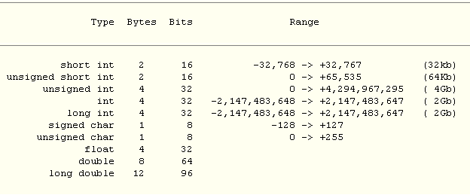
Type qualifiers
Type qualifier is special keyword that can control the basic data type to an increased range or to an decreased range slightly
:

Slide 7
Data Types In C
S.No.
Type
Size in Bits
Minimal Range
1
char
8
-128 to 127
2
unsigned char
8
0 to 255
3
signed char
8
-128 to 127
4
int
16
-32,768 to 32,767
5
unsigned int
16
0 to 65,535
6
signed int
16
Same as int
7
short int
16
Same as int
8
unsigned short int
8
0 to 65, 535
9
signed short int
8
Same as short int
10
long int
32
-2,147,483,647 to 2,147,483,647
11
signed long int
32
0 to 4,294,967,295
12
unsigned long int
32
0 to 4,294,967,295
13
float
32
Six digits of precision
14
double
64
Ten digits of precision
15
long double
128
Ten digits of precision

